Slide 1
lok sabha election 2024
File created on: 7/1/2024 12:43:12 PM

Slide 3
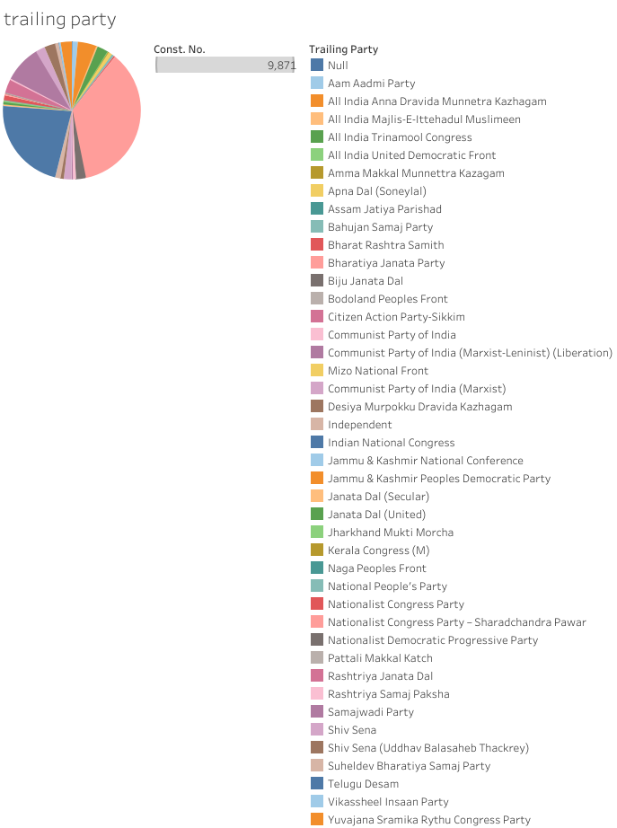

Slide 4
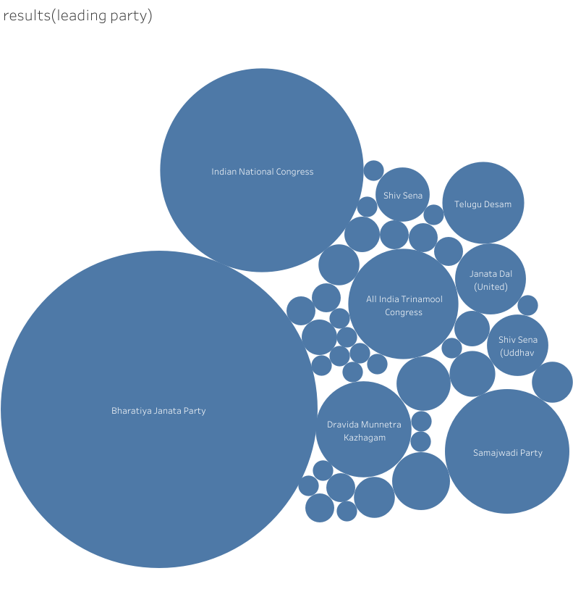

Slide 5
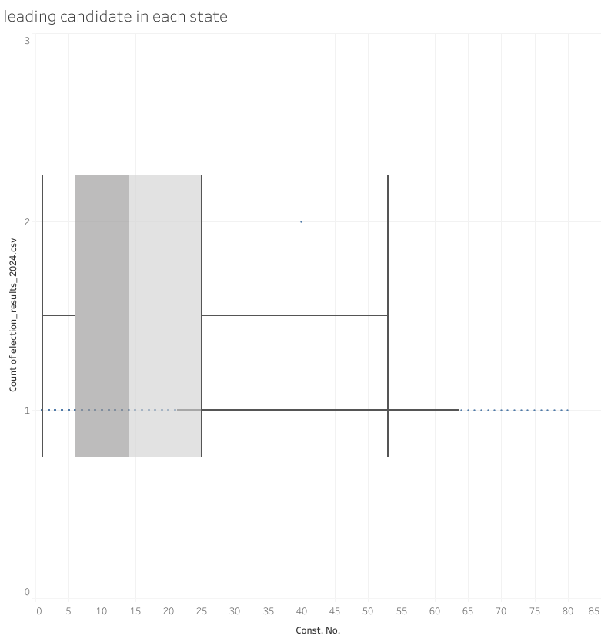

Slide 7
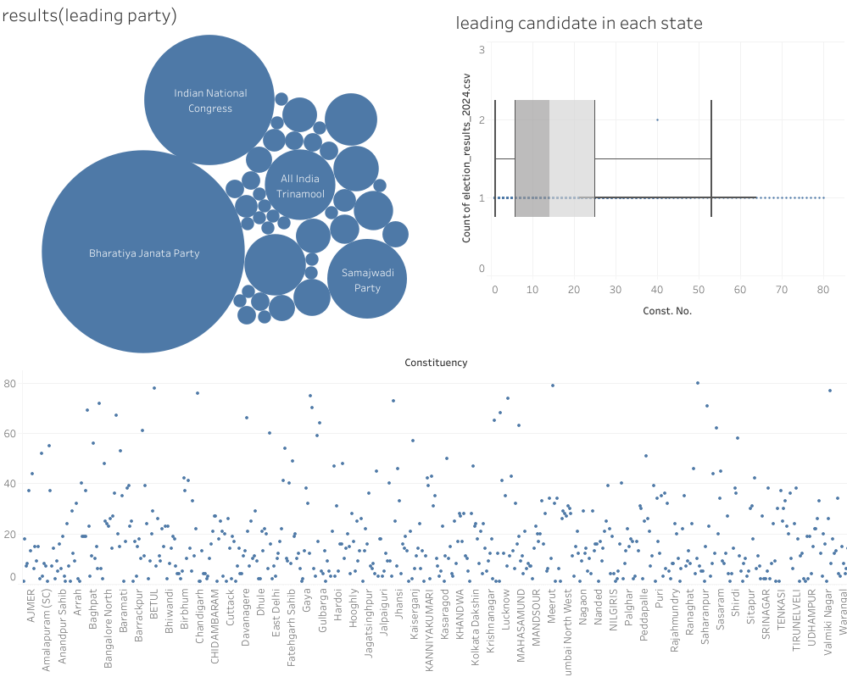

Slide 8
